Slide 1
Test plan discussion
Tower Fan

Slide 2
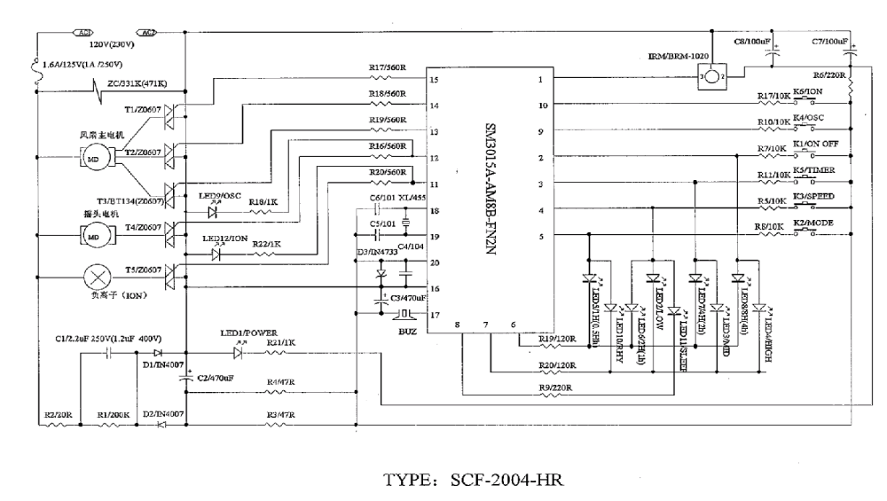
Circuit Diagram 1

Slide 3
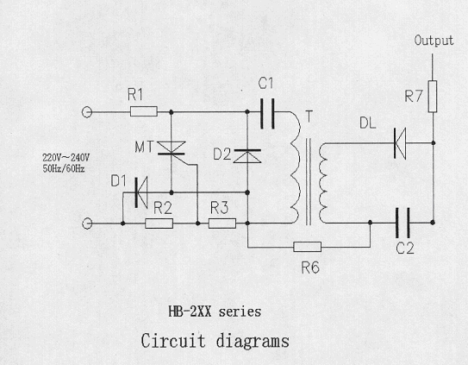
Circuit Diagram 2

Slide 4
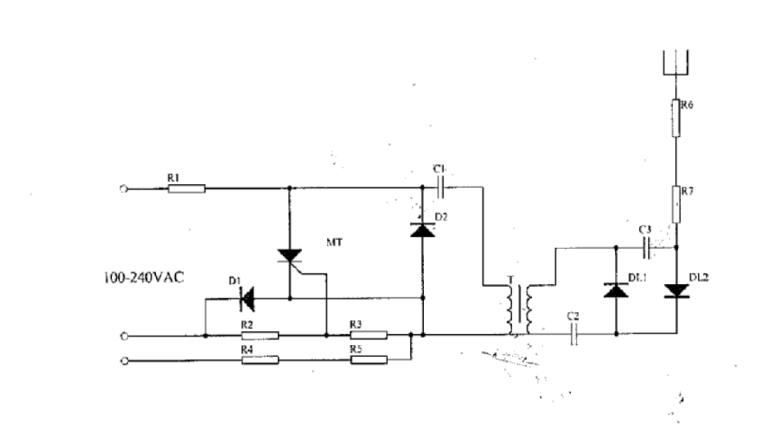
Circuit Diagram 3

Slide 5
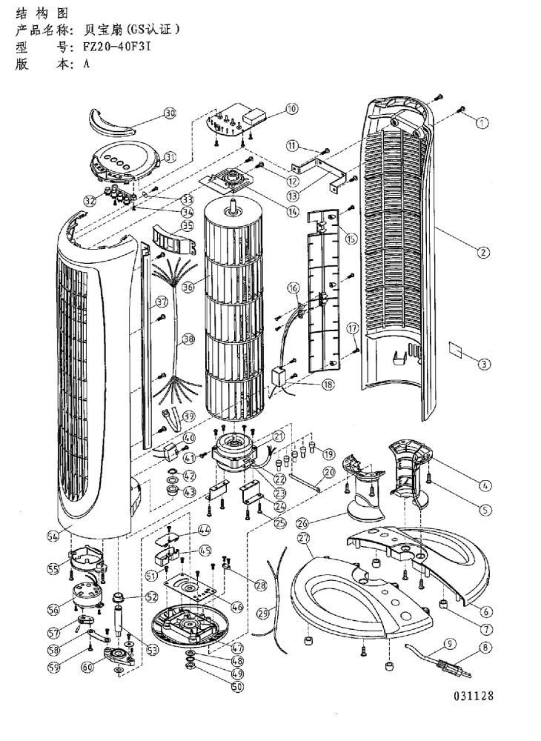
Construction

Slide 6
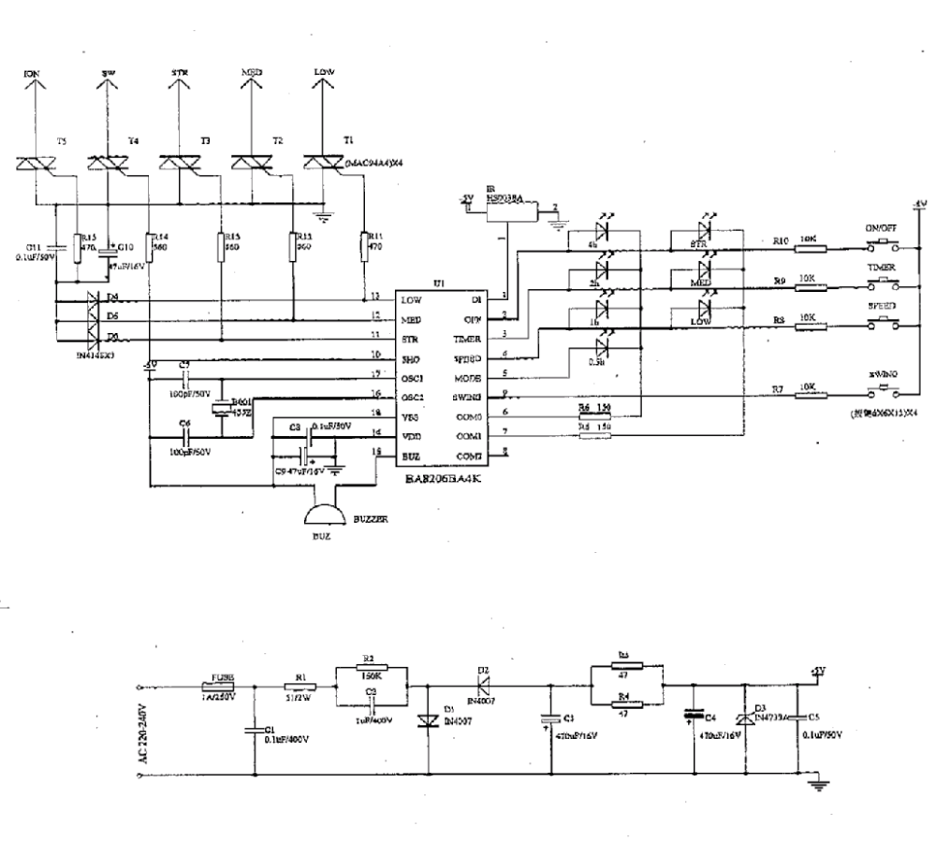
Circuit Diagram 4

Slide 7
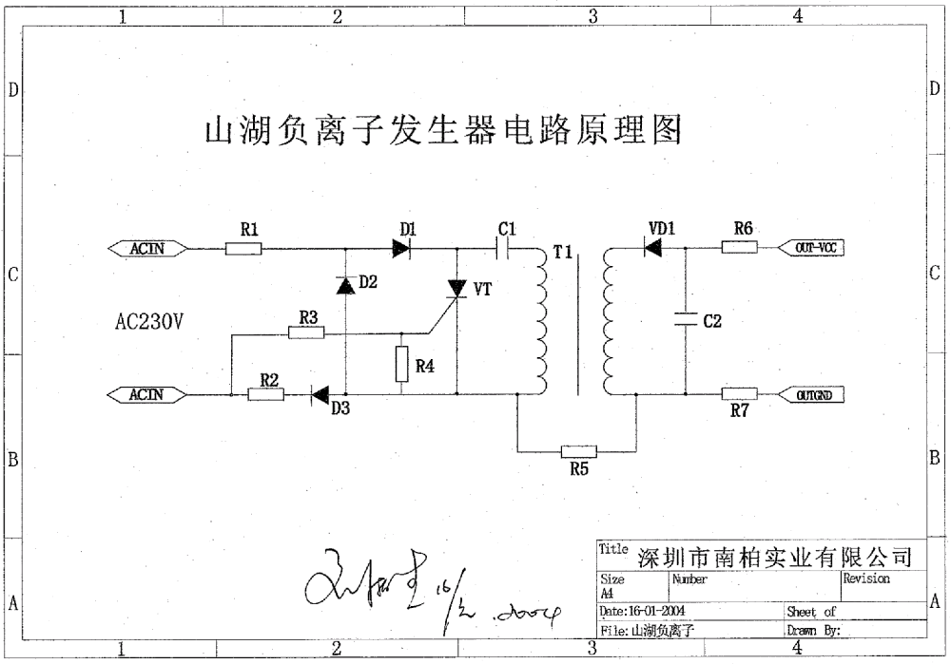
Circuit Diagram 5

Slide 8
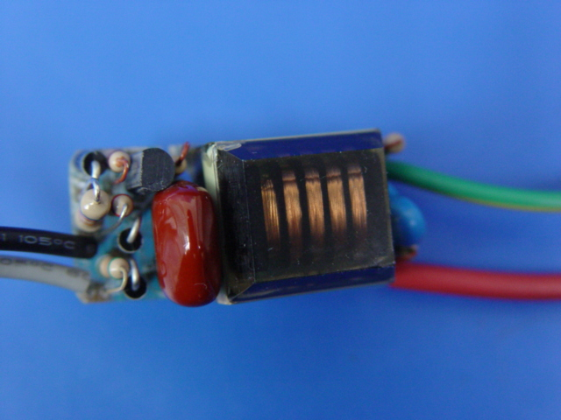
Circuit Diagram 6

Slide 9
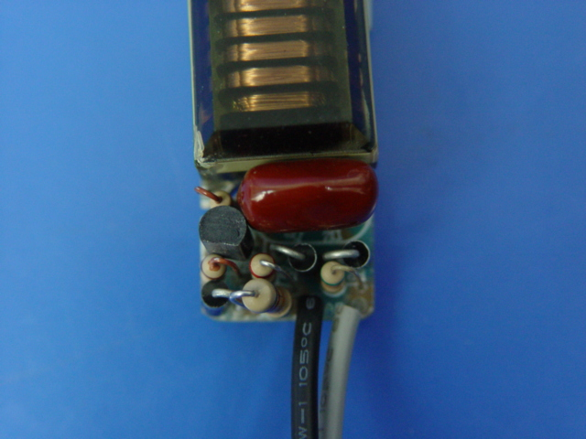
Circuit Diagram 7

Slide 10
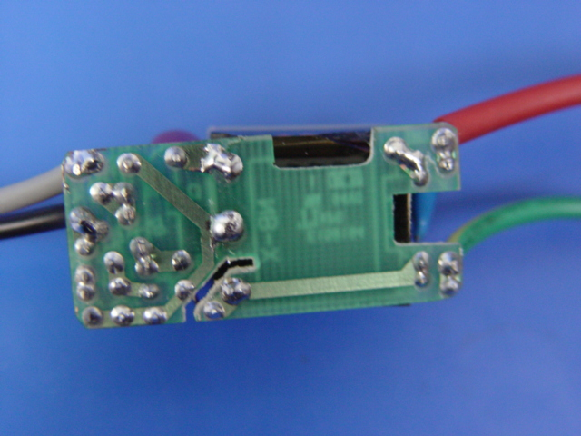
Circuit Diagram 8

Slide 11
Circuit Diagram 9

Slide 12
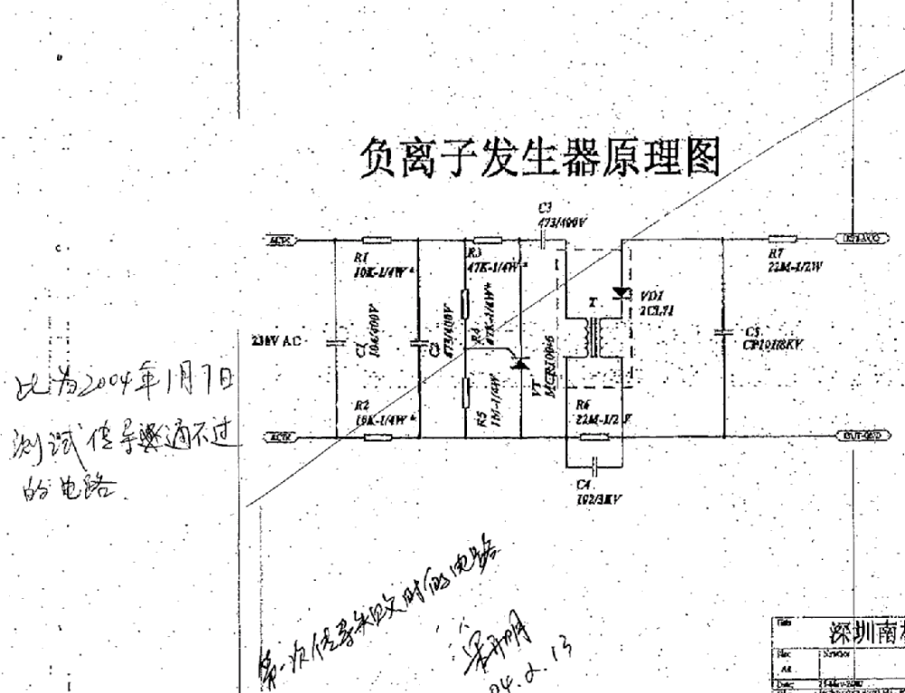
Circuit Diagram 10

Slide 13
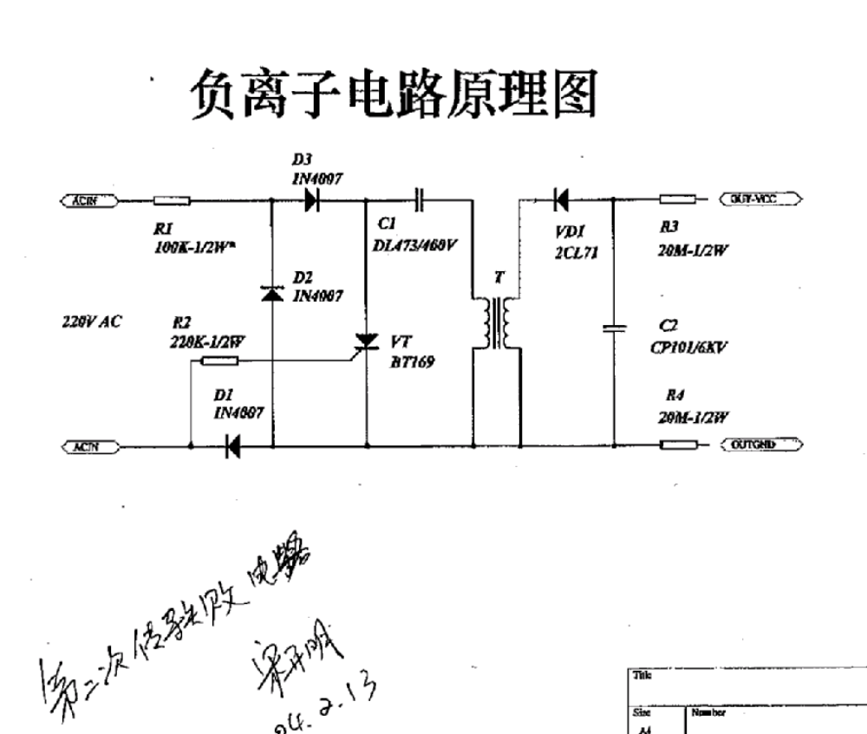
Circuit Diagram 10

Slide 14
Disturbance Source
Crystal: narrow band disturbance voltage, disturbance power
IC: narrow band disturbance, voltage & power
Triac: on/off control only, no fire angle control, click
Ionic generator: broad band disturbance
Motor: broad band disturbance, Disturbance voltage and disturbance power

Slide 15
Sensitive components for immunity test
IC (all)
Ionic generator (surge)
Triac (EFT, C/S, Surge)
Resistor of RC power supply (surge)
IC of Remote control (ESD)

Slide 16
Applicable standards
EN 55014-1:2000+A1+A2
EN 55014-2:1997+A1
EN 61000-3-2:2000
EN 61000-3-3:1995+A1

Slide 17
Test items/operation modes
Disturbance Voltage: high fan, swing, timing, ionic on
Disturbance Power: high fan, swing, timing, ionic on
Click: sleep or nature with (high fan), the mode with highest current and switching rate
Harmonics: n.a. less than 75W
Flicker: sleep or nature with (high fan), the mode with highest current and switching rate; (in case calculation not done to prove the compliance, test should be done)
EMS for Household
For all test items: stand by;
For all test items: low fan, swing, timing, ionic on, sleep
(function check is needed right after any tests finished.)

